Slide 1
Lung Cancer Data Analysis Project
Using Excel & Tableau
By: Debadrita

Slide 2
PROJECT OBJECTIVE
This project analyzes lung cancer patient data to identify demographic and behavioral risk factors associated with lung cancer cases.

Slide 3
DATASET OVERVIEW
Dataset Source: Kaggle
Total Records: 2,998
Tools Used:
Excel
Tableau

Slide 4
DATA PROCESSING & ANALYSIS
Data Collection
↓
Dataset Observation
↓
Data Cleaning
↓
Data Preparation
↓
Exploratory Data Analysis
↓
Dashboard Visualization

Slide 5
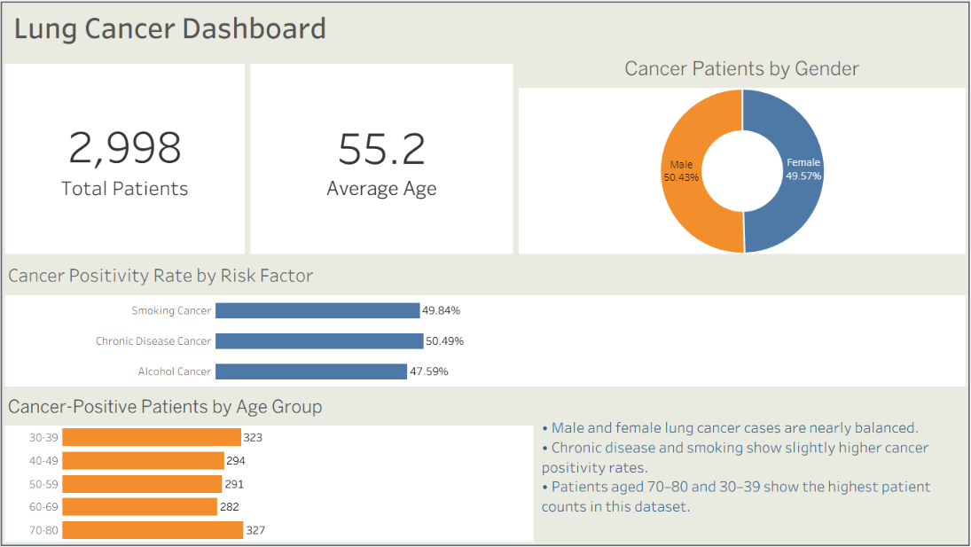
TABLEAU DASHBOARD
The dashboard summarizes patient distribution, age analysis, gender comparison, and cancer positivity rates by major risk factors.

Slide 6
KEY INSIGHTS
Male and female lung cancer patient distribution is nearly balanced across the dataset.
Smoking and chronic disease factors show slightly higher cancer positivity rates compared to alcohol consumption.
Patients aged 30–39 and 70–80 represent comparatively higher patient counts in the dataset
Chronic disease showed the highest proportion of lung cancer cases within the younger (30–39) age group compared to other factors such as smoking.
Smoking-associated lung cancer cases were also relatively higher in the 30–39 age category.
Anxiety showed the highest gender-based variation among observed symptoms, while chest pain showed the least variation.
Overall symptom distribution appears relatively balanced between genders.

Slide 7
CONCLUSION
This project helped develop practical skills in data cleaning, exploratory data analysis, dashboard development, and insight communication using Excel and Tableau.

